Slide 1
Presentation on YOUTUBE VIDEO DOWNLOADER
Submitted By:
Aaditya Raj
Ajay Shakya
Gaurav Bindal
Rajat Kaushik
DR. A.P.J. ABDUL KALAM TECHNICAL UNIVERSITY,
LUCKNOW
January-2022

Slide 2
Contents
S . No. | Title
1. | Introduction
2. | Problem Description Existing Problem Proposed Solution
3. | Hardware Software requirements
4. | Overall Block Diagram, E-R Diagram
5. | Methodology
6. | Performance Analysis
7. | Outputs
8. | Conclusion and Future Scope
 | References

Slide 3
Introduction
YOUTUBE VIDEO DOWNLOADER is a platform where people can download YouTube videos free of cost , Good quality , without add interruptions , secure users data .
Easy to use and download with interactive interface

Slide 4
PROBLEM DESCRITPION
There are many software related to this topic that helps to download YouTube videos with many demerits such as
Most of them are paid ones .
People faces server down problem .
Misuses of owners data .
Spyware and adware problem
YOUTUBE VIDEO DOWNLOADER is a fast , convenient and more secured way to download the YouTube videos only , at free of cost . In YOUTUBE VIDEO DOWNLOADER user didn’t face any server down problem , user didn’t face any adds problems while download videos , no spyware and malware threats and easy interface provide for the user .

Slide 5
Hardware and Software Requirenments
Hardware requirement :-
4 GB RAM
256 GB HARD-DISK
I3 5th gen.
Windows 10.
Software requirement :-
Visual studio code

Slide 6
Block diagram
START
START
COPY THE LINK
COPY THE LINK
PASTE THE LINK
DOWNLOAD
USING PYTHON
MODULE
TKINTER
PYTUBE
END

Slide 7
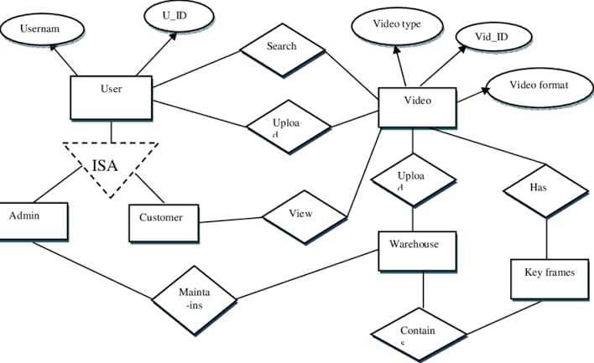
E-R DIGRAM

Slide 8
Methodology
First we will copy the link of the video we want to download.Then we will paste it in the “paste the link” box.
Then we will click on “download” option
Then the downloader will download the video .

Slide 9
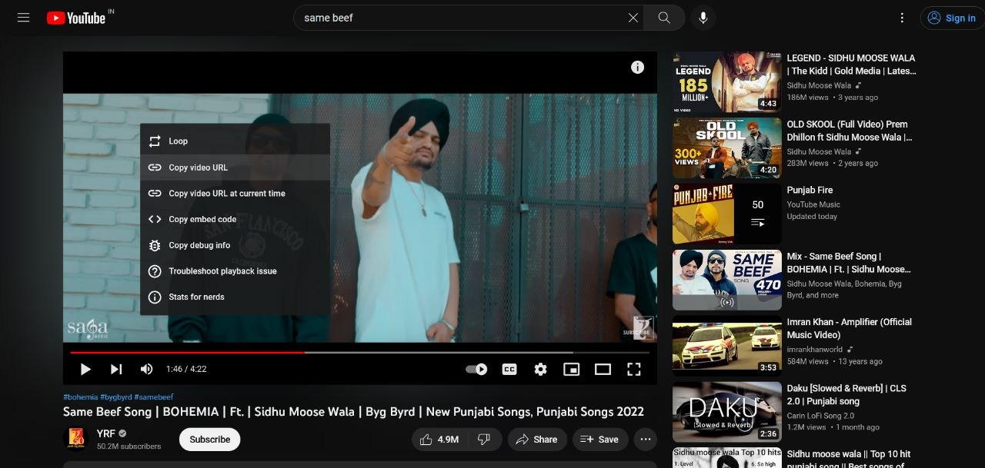
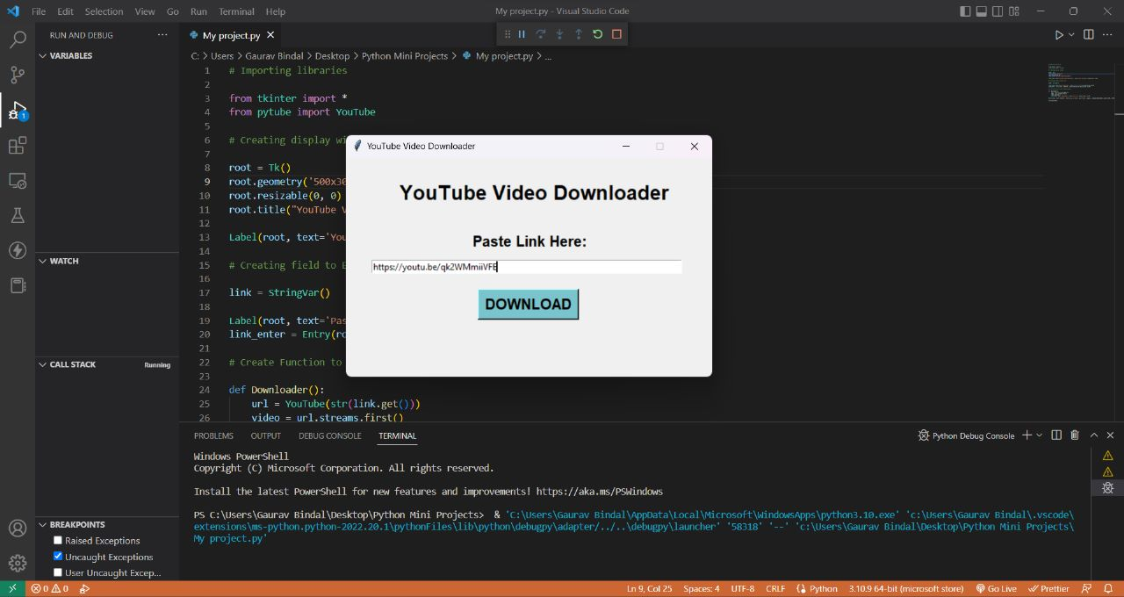
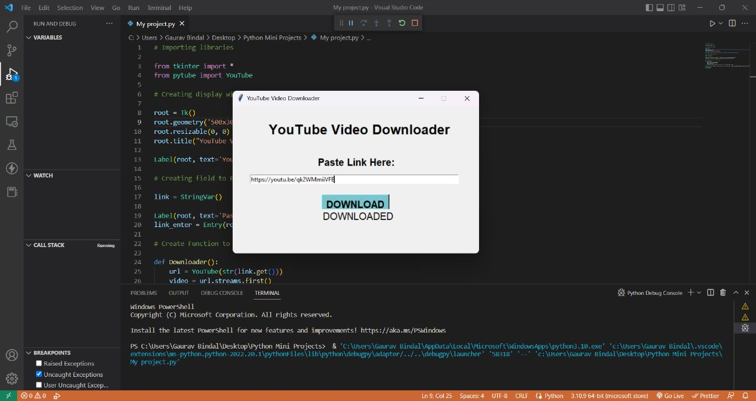
Output

Slide 10
Conclusion and Future Scoop
In future, we can add some new features like to download video from other social media platforms like instagram, facebook, etc. Also, will enhance the quality of it.

Slide 11
Reference

Slide 12
THANK YOU

